Slide 1
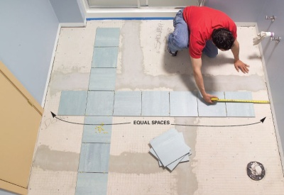
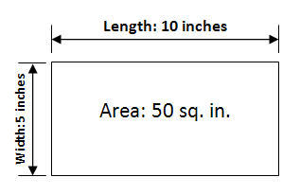
I
Length times Width
LxW
Measures the space of a flat surface
Area
2-D
2 dimensional
Area Bubble Map

Slide 2
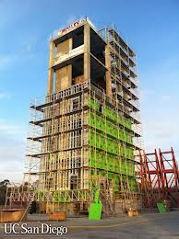
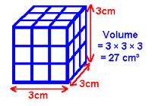
I
Length times Width times
Height
LxWxH
Measures the amount of space inside an object
Volume
3-D
3 dimensional
Volume Bubble Map

